Slide 1
Value Canvas and Value pyramid
IMT2019525 VIJAY JAISANKAR

Slide 2
Lime

Slide 3
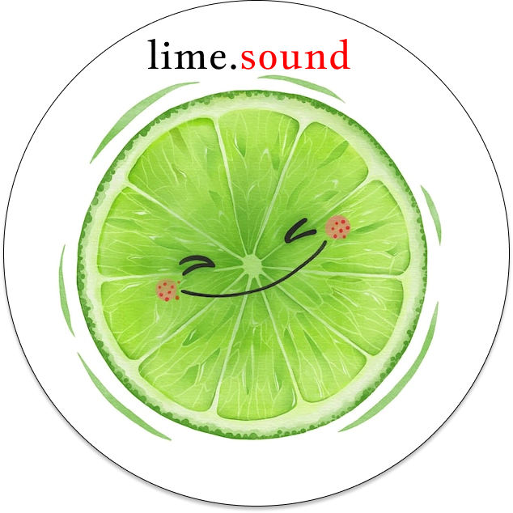
Lime: An end-to-end music creation, hosting, and promotion platform for budding creators.

Slide 4
Mission statement: Harness the power of communities and make your sounds heard.
Vision statement: To be the top preferred music platform for any new creator, anywhere.

Slide 5
Lime
Vijay Jaisankar
17/10/2022
1.1
Budding creators find it expensive to get music their career started due to the cost and contractual issues with record companies
Advanced musical software needs complex hardware to run and is very specialised
Built-in tools and extendability through OSS
Fair and cheap hosting and licensing
Web-based music discovery platform
Open-sourced and accessible tools, combined with an open and inclusive community, leads to an inviting platform for budding creators.
The Open-source community, when combined with the creator ecosystem, forms a strong bond with the platform that keeps on growing.
Lime allows creators to focus on their music, and it takes care of the rest.
Budding music creators
Casual listeners looking for new artists to listen to
There are many (costly) paid, and open source libraries that help make software, but they suffer from the lack of extensibility
There are also sites that host music for creators - our product adds creational benefits to this.
User acquisition and music upload rates
Community support through new plugins and discussions
Hit(Click) count trends
Soundcloud, Audacity, ChillHop, and FIgma - all in one, for music creators.
Social Media
Github
Chat servers
Referrals
Small creators/music clubs who will try the product
Software developers in the audio domain
Marketing costs
Development costs
Hosting and maintenance
Advertisements shown to casual listeners
Premium (ad-free) subscriptions’ revenue
Collaborations with artists
Lean Canvas is adapted from The Business Model Canvas (www.businessmodelgeneration.com/canvas). PowerPoint implementation by: Neos Chronos Limited (https://neoschronos.com(https://neoschronos.com). License: CC BY-SA 3.0

Slide 6
Clarifications

Slide 7
Unfair advantage
The Open-source community, when combined with the creator ecosystem, forms a strong bond with the platform that keeps on growing.
Such a holistic platform “saves” new creators from predatory labels and offers a no-holds-barred and transparent experience, so that the creators can focus on their work and not worry about anything else.

Slide 8
Could this be a two sided platform?
Lime is democratic - any user can be an artist and publish their work.
An interesting addition to this business model is Auctions: artists can quote their prices and Lime can facilitate fairer earnings.
We feel like this feature is an exciting future prospect for Lime after it gets a good amount of credibility (and hence builds trust) in the community.

Slide 9
Could this also be a collaborative platform for artists and accompanying artists?
Yes - this is a brilliant idea and thanks for the suggestion!
Lime is based on the ideals of communities and sharing is a key indicator of growth.
Artists can collaborate with other artists and publish music as “groups”.
The music-making tools will also be collaborative and real-time.

Slide 10
Value proposition canvas

Slide 11
Lime
Vijay Jaisankar
17/10/2022
1.0
Lime offers an easy-to-use, dependency-free, collaborative, and powerful software to make and host music.
It also involves a rich community to make connections with other creators and foster collaborations
Strategic placement of advertisements and a more organic content discovery system help users find music safely and easily
As this product is built on the open-source code written by users themselves, they essentially build their product themselves.
Creators want to make new songs and expand their discographies
Creators want to engage with other creators and find new audiences
Casual users want a less intrusive way to find new music
People in the ecosystem can find a way to actively contribute to the products they use.
The main pillars of Lime are
Web-based music production software
Easy content hosting and management platform
The open-source and music community that underpins the user base
Artists want to make music and focus only on that - they shouldn’t worry about contracts, publishing, and storage.
Casual listeners want to find budding artists to support and find like-minded individuals
Open-source contributors want to build a large-scale product and support the community
Lime offers a very low entry barrier and negligible royalty free along with legal protection
Un-intrusive ads and the underlying community make finding new music very easy
Lime is completely free to use and publish
Large companies and labels take an eye-watering cut from their producers
Users are usually bombarded with in-music ads and sponsored content that do not allow them to find music organically
Most of the music production software is quite expensive and offer a high barrier to entry
Lime: An end-to-end music creation, hosting, and promotion platform for budding creators
Budding artists, Music enjoyer, open-source developers
Design and Copyright by: Strategyzer AG (https://www.strategyzer.comDesign and Copyright by: Strategyzer AG (https://www.strategyzer.com/). PowerPoint implementation by: Neos Chronos Limited (https://neoschronos.com). PowerPoint implementation License: CC BY-SA 3.0

Slide 12
Value pyramid

Slide 13
Source
https://media.bain.com/elements-of-value/#

Slide 14
Functional
Lime saves time for artists as they don’t need to waste time on installing and setting up software, and integrates them directly to their publishing platform.
It simplifies the entire process as it is an all-in-one tool; and reduces their risk of publishing as they’re not contractually bound to quantity or time-frame based agreements with any record labels.
It also connects them with other creators and listeners, hence making them appeal to a larger audience.

Slide 15
Emotional
Lime rewards loyal listeners and artists through custom badges that they can show on their profiles.
Its design is made with accessibility and ease-of-use in mind, so Lime can be used by as many people as possible.
Music is a great source of entertainment for many, and Lime is the ideal platform for anyone to discover new music.

Slide 16
Life-changing
The Lime community makes people feel a strong sense of belonging, and this community is what spurs its growth.
Starting a project is normally quite hard, Lime intends to change this and motivate more people to make music because it’s only a few clicks away.

Slide 17
Social Impact
As Lime is democratic and transparent, artists of marginalised communities can make their voices heard and showcase their unique takes on music.

